Slide 1

Critical Decision Points in Dementia Care
Elizabeth A. Crooks, DNP, RN, CNE
Instructor; Nurse Educator Masters Track Coordinator
WHO Collaborating Center Scholar

Slide 2

Audience Survey
Use 5 words or less:
On the Green index card, answer this question
“What makes a good day?”
On the Red card, answer this question
“What is your most important/fulfilling role in your family?”

Slide 3
What we are exploring today
Who are the decision makers?
What points in dementia care require important decisions?
What guides our choices?
What does research tell us about these decisions?
Who can help us decide?

Slide 4
Who gets to decide?
The person with dementia
The primary caregiver
The family
The medical team

Slide 5
When do these decision points occur?
Diagnosis
Initial Treatment
Daily Living with Dementia
Lifestyle and Role Changes
Autonomy and Independence
When Death is Near

Slide 6
Decision Point #1
Diagnosis
Initial Treatment
Daily Living with Dementia
Lifestyle and Role Changes
Autonomy and Independence
When Death is Near

Slide 7
“and the survey says…”
If someone you loved had Alzheimer’s disease, would you want them to know?
Green Card YES Red Card NO
If YOU had Alzheimer’s disease would YOU want to know?
Green Card YES Red Card NO

Slide 8
Decisions the health care team must make:
Is it dementia?
What can be reversed or optimized?
Who to tell and how?
Studies say to share diagnosis
Many families are opposed to telling patient
Who are the caregivers and proxy decision makers?
May be difficult to identify
Many PCPs uncomfortable with change in decision maker as dementia progresses¹
1, Adams et al, The Gerontologist 2005:45 : 231-239

Slide 9
Current Diagnostic Criteria for Dementia
Cognitive losses that interfere with function at work or usual activities
A decline from a previous level of functioning
Not delirium or psychiatric disorder
Diagnosed by history and examination (not a test/procedure)
Involves at least 2 cognitive domains:
Memory
Reasoning and judgment
Visuospatial
Language
Personality, behavior, comportment
McKhann et al, Alzheimer’s and Dementia, April 2011

Slide 10
What Families Want
Accurate diagnosis
Sensitive & appropriate sharing of diagnosis
Referrals for services (medical & community)
Access to medications
Written dementia materials
Ongoing support and advice
Alzheimer Disease Society. Right from the start: Primary health care and dementia. 1995:London, Alzheimer’s Disease Society

Slide 11

Meet Mrs. P.
A 76 year old woman, widowed and living alone
Admitted with a fractured patella after being struck by a car
Nurses identified cognitive deficits that impeded care
Difficulty recognizing objects and people
Could not find walker at bedside
Mistook niece for health care provider
Developed intermittent agitation and marked confusion
Paranoid statements: “Someone took my clothes!”
Wandering: Stated “I need to get to the bank.”

Slide 12
Dementia in the Hospital Setting: What research tells us
Hospitalization rates double
Length of stay increases
70% of acute confusion/delirium occurs in dementia patients
In many cases the dementia was previously unrecognized
Higher service use in the two years before diagnosis
Weiler PG et al. Am J Public Health. 1991;81:1153-1157.
McCormick WC et al. J. General Internal Medicine.1995;10:187-193

Slide 13
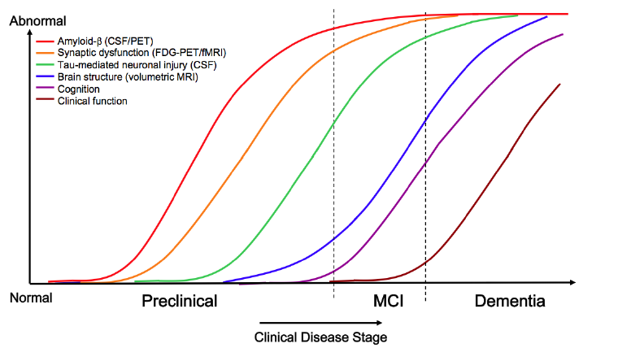
A little more research Alzheimer’s starts years before memory loss
Sperling et al. Alzheimer’s and Dementia, 2011;7:280-92.

Slide 14
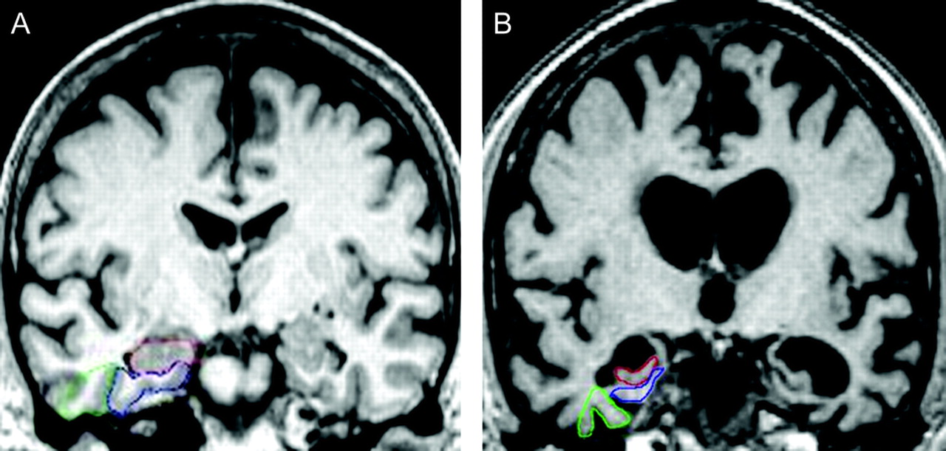
How can we tell? We can see brain changes on scans
Normal
Alzheimer's Disease
Duara et al, Neurology 2008:71:1986-92

Slide 15

Warning Signs of Dementia
Often only noted in retrospect
Vague complaints
Difficulty expressing symptoms
Unexpected weight loss
Doesn’t follow instructions for treatment
Poor prescription management
Confused by refills; Within-disease polypharmacy
Missed/rescheduled/wrong day appointments
Changes in grooming/hygiene/appearance

Slide 16
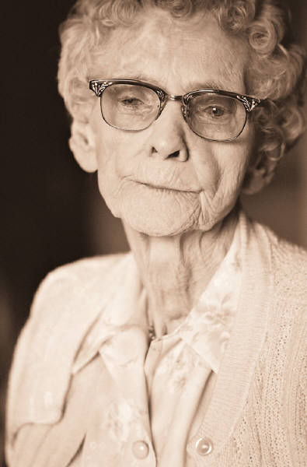
Mrs P. : Odd behaviors or odd person?
Family reports prior to accident:
Paced around her apartment complex in fur coat
Once wore farmer’s overalls to the opera
Often awake all night, hard to awaken during day
Always a “night-owl”
Refused to shower
Usually took bi-weekly sponge-baths at home
Rummaged through apartment with the idea that things have been stolen
Always disorganized – “a ditz”

Slide 17

Decisions the affected person and family must make:
Sharing diagnosis
Who should know?
How should they be told?
Is it in the cards?
Mrs. P’s experience:
Anger and humiliation
Family disbelief
Need for support

Slide 18
Who can help with these decisions?
Health care professionals
Nurses, social workers, family therapists
Advocacy groups
Local resources (Alzheimer’s of Central Alabama)
National resources (multiple organizations)
Clergy

Slide 19
Decision point #2
Diagnosis
Initial Treatment
Daily Living with Dementia
Lifestyle and Role Changes
Autonomy and Independence
When Death is Near

Slide 20
“and the survey says…”
Would you want to take a drug for AD that did not IMPROVE your memory?
Green Card YES Red Card NO

Slide 21

Decisions the health care team must make:
What are good treatment recommendations?
Drugs
Non-drug approaches
What are suitable medication options?
Weighing benefit and risk
Consider cost and effectiveness
Short term and long term successes

Slide 22
Approved Anti-Dementia Agents: Dosing and Costs
Donepezil (Aricept)
Tablets (5mg, 10mg) - $180/ month generic
Matrix tablet (23mg) - $280/month
Galantamine (Razadyne)
ER tablets 8, 16, 24mg - $120/month generic
Rivastigmine (Exelon)
Patch 4.6, 9.4, 13.3 mg/24°- $280/month
Memantine (Namenda)
Tablets 5, 10 mg $240/month

Slide 23

What do our current medicines do?
They help brain cells work better
They do not improve memory in most people
They do delay worsening of memory
They do help maintain independence
They do reduce caregiver burden
They do not restore brain cells or help them live longer
They do not prevent brain cell death
They do not reverse the Alzheimer plaques

Slide 24
Decisions the affected person must make:
Do I take the medicines?
Is the benefit to ME worth the risk and cost?
Are the benefits important enough to my family for US to accept the costs and risk?
Do I seek alternatives?
Weak scientific evidence for efficacy
Many proprietary companies
Patients and families claim to benefit

Slide 25
What did Mrs. P do?
Hospital physician recommended use of donepezil because :
Couldn’t describe upcoming Christmas holiday
MMSE=18/30 (moderate impairment)
After discharge she didn’t recall details of hospitalization
Did not understand why she had “all those pills”
Did not refill the prescription
Notes:
KEY POINTS
Mrs. P returned to her family doctor for a follow-up visit 1 month after being discharged from the hospital.
Her physical examination revealed no abnormalities; her vital signs were stable.
She was alert and conversational, but her speech was rambling.
She doesn’t recall her hospitalization and can’t describe her holiday plans for next week.
Her MMSE score was 18. Her FAQ score was 21.
Her husband has been managing the family finances and overseeing the cooking.
Mrs. P is not bathing or cleaning herself effectively at the toilet.
Her husband admits to being tired.
Mrs. P has been wandering around the house at night.
Mrs. P has been staying alone at home during the day, while her husband manages the errands, etc.

Slide 26
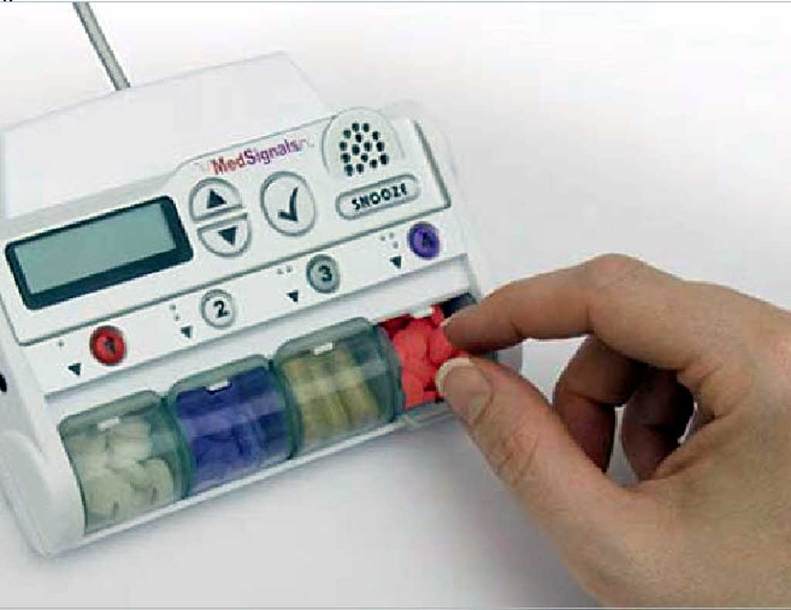
Who or what can help with these decisions?
Family
Members of health care team
Local Pharmacists
Patient assistance plans
Technology – Is there an app for that?

Slide 27
Decision point #3
Diagnosis
Initial Treatment
Daily Living with Dementia
Lifestyle and Role Changes
Autonomy and Independence
When Death is Near

Slide 28
“and the survey says…”
Look at your RED card, where you wrote the important role:
How would it feel to hand off that role?
It would be easy:
GREEN CARD
It would be hard/impossible:
RED CARD

Slide 29
Decisions the health care team must make:
What level of function is supported by the retained cognitive skills?
What risks emerge from the cognitive losses?
How can the person be protected from those risks?

Slide 30
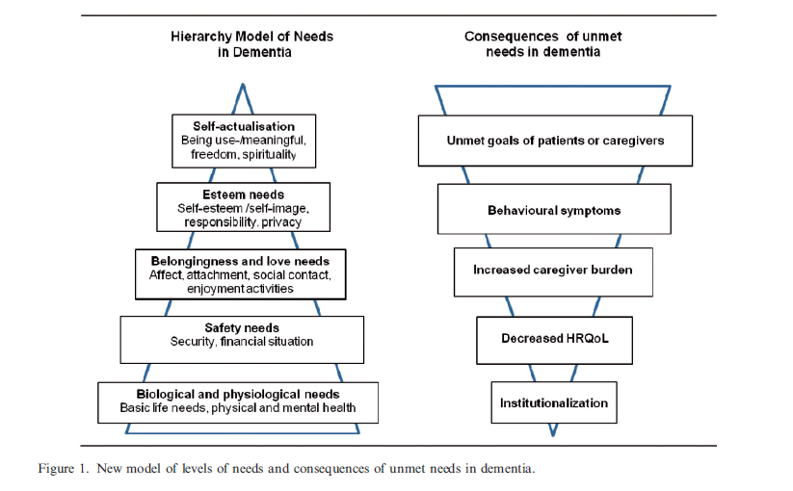
Mapping Maslow’s Hierarchy to the Person with Dementia
Scholzel-Dorenbos CJ et al Aging and Mental Health 2010;14:113-119

Slide 31

Nonpharmacologic Approaches: Key Points for Caregivers
Safety and supervision
Cooking / Nutrition
Wandering
Susceptibility to exploitation
Activity
Plan activities as part of the routine
Physical and mental activities are ideal
Social interactions can be potent stimulants
Don’t discount the roles of sunshine/fresh air
Notes:
By necessity, caregivers are placed in the role of monitoring patient safety. While a balance between individual autonomy and personal safety should be a goal of AD management, safety must be prioritized. This has negative consequences for many caregivers, who may depend on the patient for transportation, or need to leave the patient unattended in order to continue employment.
Maintaining activity has many benefits for the patient. An active patient is likely to sleep better and feel more fulfilled from each day. Poor motivation often limits the patient’s ability to initiate activities, so that the caregiver becomes the driving force in maintaining a favorable level of engagement. Positive activities should be built in to the daily routines of patient and caregiver, and can be facilitated through socially driven interactions such as clubs, senior centers, and adult day programs.

Slide 32
Preserved Abilities In Mild Dementia: Building on Strengths
Habits
Location learning/Environmental cueing
Motor learning
Classical conditioning
Repetition priming
The ability to improve performance after initial exposure to information
NOTE: losses in these domains are unpredictable
Courtesy Cameron Camp, PhD

Slide 33
Decisions the affected person and caregivers must make:
How do we support social engagement?
What lifestyle changes can we manage?
Who is willing to take on new roles or support the affected person in fulfilling role expectations?
How will we respond to the need for an abrupt transition?

Slide 34
Mrs. P. struggles at home
Son living in the home was unreliable
Mental health issues/Financial exploitation
Report made to Adult Protective Services by neighbor
Contracted home health service
Deemed intrusive by Mrs. P and exploitative by family
Paid caregiver’s health issues precluded Mrs. P’s usual long daily walks
Mrs. P reported distress at being under “house arrest”

Slide 35
What did Mrs. P do?
Continued to engage in meaningful social activities
Walked to Mass every Sunday
Made monthly trips to the Metropolitan Opera House
Traveled by bus to visit family in neighboring states
Identified niece as a trustworthy confidant
No plans were made for an abrupt transition

Slide 36
Who can help with these decisions?
Advocacy Groups
Healthcare Team
Case management; Social services
Trusted family members or friends
Family’s community or social network
Clergy

Slide 37
Decision point #4
Diagnosis
Initial Treatment
Daily Living with Dementia
Lifestyle and Role Changes
Autonomy and Independence
When Death is Near

Slide 38
“and the survey says…”
Autonomy is the ability to MAKE DECISIONS for yourself
Independence is to ability to DO THINGS for yourself
Which would be more painful for you to see in someone you love?
Loss of Autonomy:
GREEN CARD
Loss of Independence:
RED CARD

Slide 39
Decisions health care team must make:
When to recommend to stop driving
When to recommend 24/7 supervision
When to activate proxy decision makers
How to manage problem behaviors

Slide 40

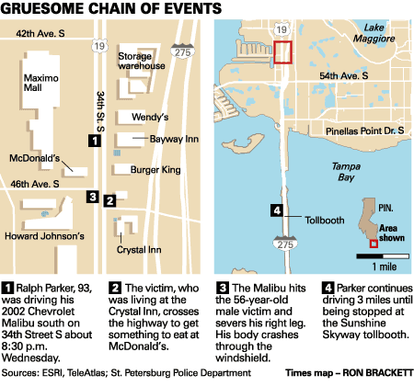

Driver goes 3 miles with lodged body
A motorist hits a pedestrian on 34th Street, then drives to the Sunshine Skyway with the victim stuck in the windshield.
By CRAIG PITTMAN, Times Staff Writer Published October 20, 2005
ST. PETERSBURG, FL - A 93-year-old motorist struck and killed a pedestrian Wednesday evening, then drove about 3 miles with the body lodged in the windshield until he was stopped at a Sunshine Skyway tollbooth.
The driver told officers he thought the body had fallen from the sky, said St. Petersburg police Officer Mike Jockers. "He had no idea he had been involved in an accident," Jockers said. "He doesn't totally understand what happened.“
The driver, who lives in Pinellas Park, told police that he was headed home. Pinellas Park, however, is miles in the opposite direction. "Obviously, he was confused," Jockers said. "Incredibly confused."

Slide 41
Guidelines on Driving American Academy of Neurology Practice Parameter
For patients with dementia, driver self report does not predict risk
>80% of drivers consider themselves above average
“There is insufficient evidence to make conclusions about the utility of neuropsychological testing to predict driving risk”
Even detailed cognitive tests are poor predictors of driving safety
Iversen et al, Neurology 2010;74:1316-24

Slide 42
Guidelines on Driving American Academy of Neurology Practice Parameter
Crash risk in dementia is associated with:
Prior crashes and tickets
Caregiver report of marginal or unsafe driving
MMSE ≤ 24
Aggressive and impulsive personality change
Iversen et al, Neurology 2010;74:1316-24

Slide 43
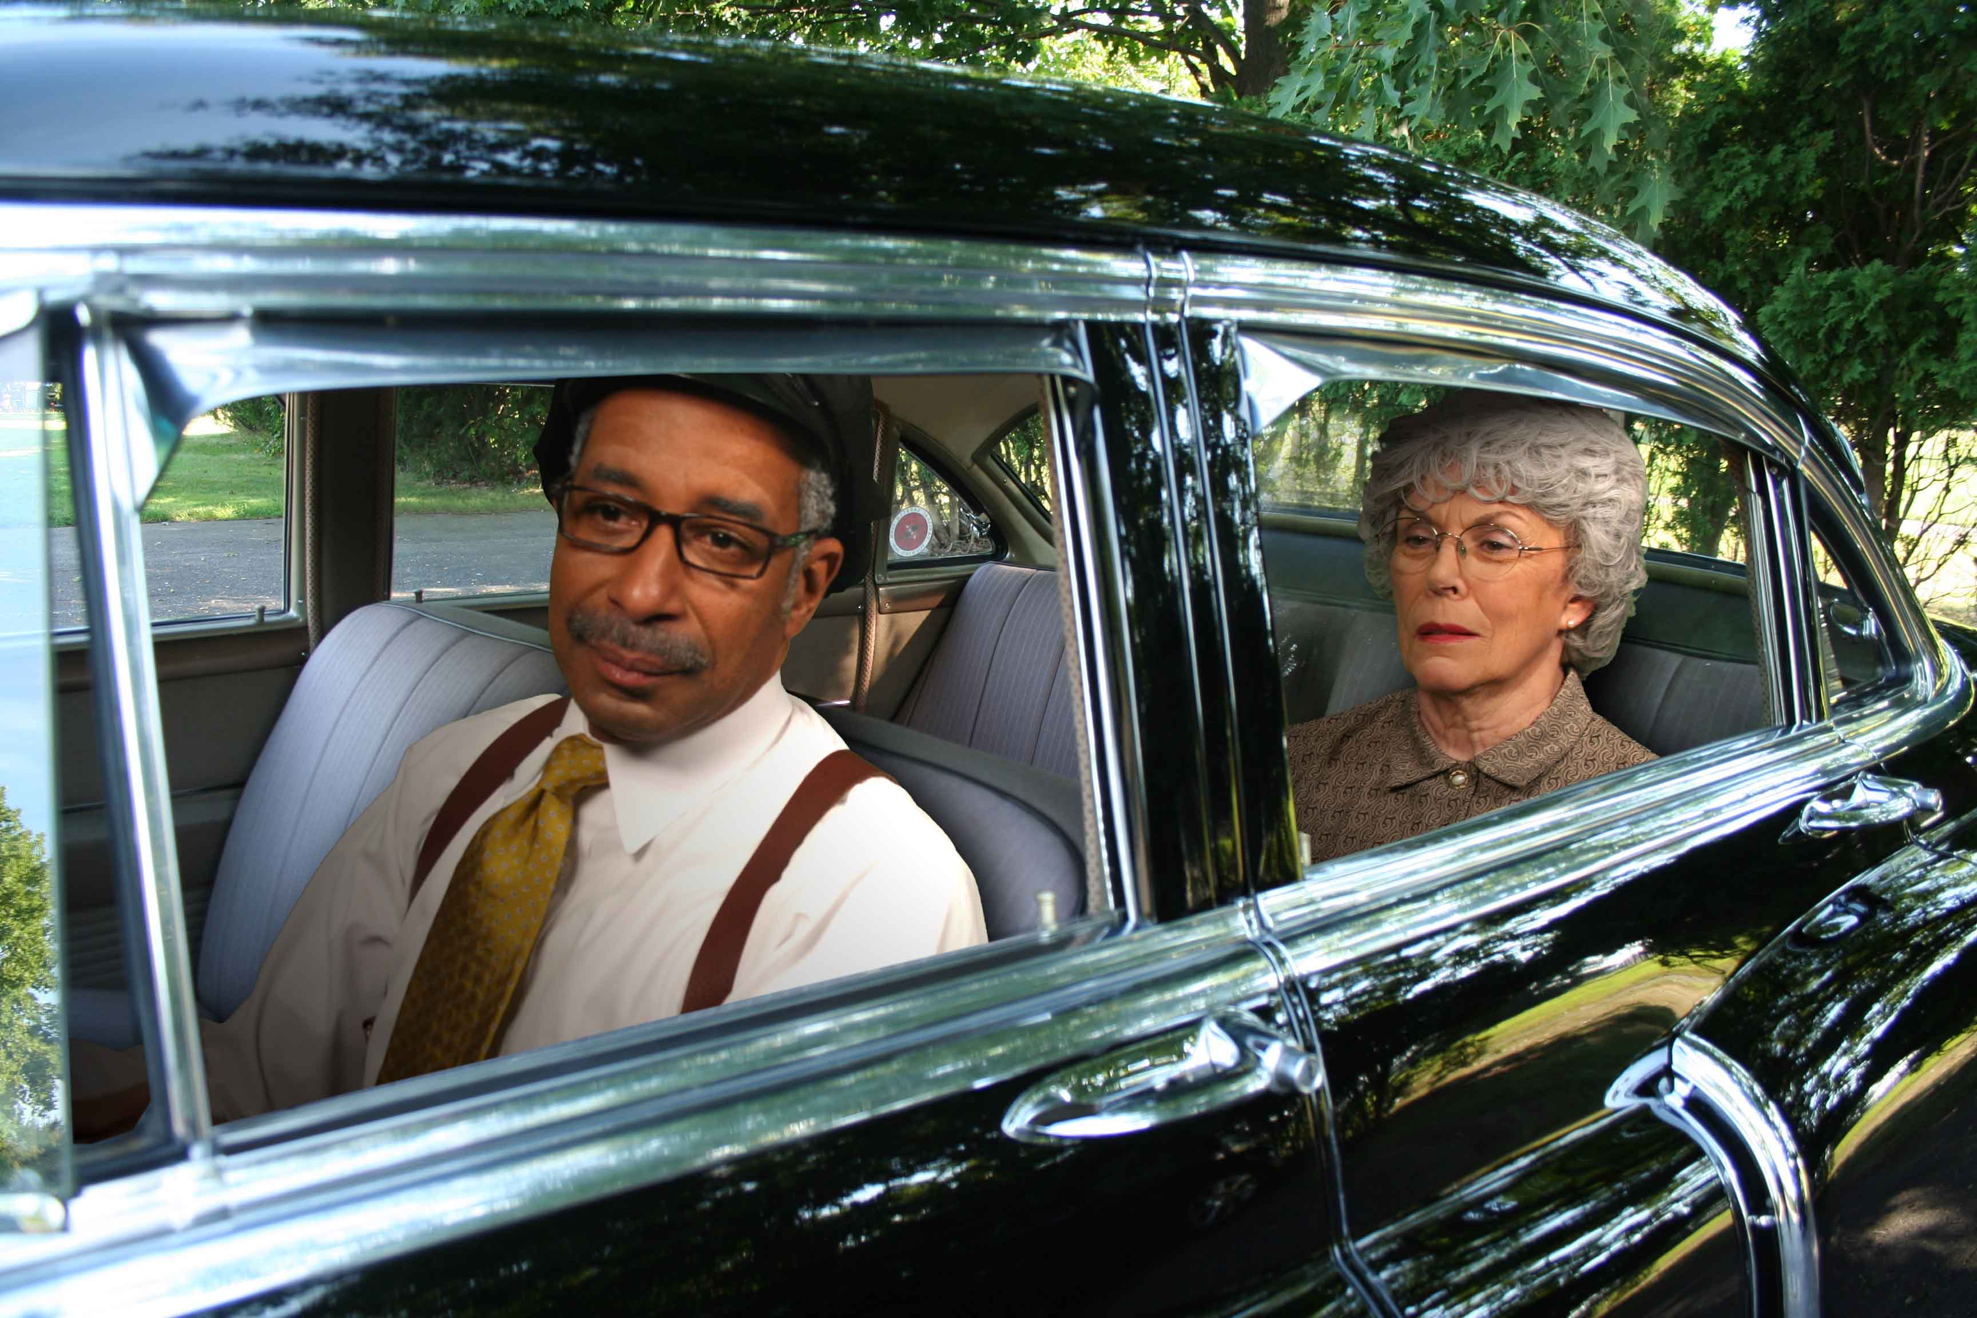
Driving Cessation Downstream Adverse Effects
Loss of independent role / identity
Increased depressive symptoms
Increased burden to caregivers, including work cessation
No increased use of alternatives to private vehicles
Eisenhandler Int J Aging Hum Dev 1990;30:1-14
Marottoli et al. JAGS 1997;45:202-6
Taylor & Tripodes Accident Anal Prev 2001;33:519-28

Slide 44

Minimizing Problem Behaviors Nonpharmacologic Approaches:
Sleep cycle disturbances
Increase daytime activity
Minimize drug use
Purposeless activity
Provide a purpose (fold laundry, etc.)
Use as a trigger for exercise
Toileting
Use schedules
Minimize drug use
Notes:
Apart from the general approaches, some specific problem behaviors respond optimally to nonpharmacologic treatments. These include sleep disturbance, urinary incontinence, and purposeless behavior.
Many patients spend inactive days in front of television sets or just sitting quietly while the caregiver carries out all the responsibilities of the household. The patient’s quiet time also includes frequent dozing and catnaps. By the end of the day, the caregiver is exhausted and the patient is too well rested to go to sleep. Medications may help to induce sleep, but none will prolong it, so the period of wakefulness is simply shifted later into the night. Increased daytime physical activity will help to alleviate this vicious cycle much more than any medication plan.
At the opposite end of the behavioral spectrum is the individual who rummages, wanders, paces, or picks at things for long periods. These behaviors are usually more distressing to the caregiver than the patient and are a common complaint leading to sedative medication orders. In general, it may be useful for the caregiver to “entrain” these behaviors into some more useful activities, such as exercise or household chores, or at least to provide a safe outlet for the nervous energy like folding laundry.
Incontinence in AD is frequently multifactorial and may include impaired recognition of the physiologic signals associated with bladder filling. Typical urinary incontinence drugs like oxybutinin operate through anticholinergic mechanisms that can magnify cognitive impairments in AD. Nondrug management, by maintaining an empty bladder, is a more effective way of dealing with incontinence in AD patients.

Slide 45
Decisions affected person and families must make:
How do we ensure affected person does not drive?
Will we use a formal driving evaluation?
What options do we have for transportation?
How do we maintain safety?
Who will do the daily care activities?
Who will handle the business issues?
How do we want to spend our resources?

Slide 46
Mrs. P’s Autonomy Suffers
Durable power of attorney was needed
Often forgot to pay rent and bills
Could not remember insurance
Required 24 hour supervision
Son stated he would stay with her
Home health assessment
The stove had been turned off by building management months earlier due to recurrent smoke alarms
Family was unaware of the loss of cooking ability

Slide 47
Mrs. P’s Independence Suffers
Unable to remain at her apartment
Became malnourished
Safety needs could not be met
Returned home by police twice
Unable to maintain personal hygiene needs
Unable to reliably manage her medicines
Notes:
KEY POINTS
Mrs. P returned to her family doctor for a follow-up visit 1 month after being discharged from the hospital.
Her physical examination revealed no abnormalities; her vital signs were stable.
She was alert and conversational, but her speech was rambling.
She doesn’t recall her hospitalization and can’t describe her holiday plans for next week.
Her MMSE score was 18. Her FAQ score was 21.
Her husband has been managing the family finances and overseeing the cooking.
Mrs. P is not bathing or cleaning herself effectively at the toilet.
Her husband admits to being tired.
Mrs. P has been wandering around the house at night.
Mrs. P has been staying alone at home during the day, while her husband manages the errands, etc.

Slide 48
What did Mrs. P do?
Appointed niece as proxy decision maker
Met with family lawyer
Temporarily lived with age-peer relatives
They were overwhelmed by her dependence
Moved to ALF near her eldest son in Huntsville
Unable to meet Alabama ALF standards
Placement in Dementia Care Unit in <4 months

Slide 49
Who can help with these decisions?
Elder law attorneys
Financial and estate planners
Social workers
Case managers
Advocacy groups

Slide 50
Decision point #5
Diagnosis
Initial Treatment
Daily Living with Dementia
Lifestyle and Role Changes
Autonomy and Independence
When Death is Near

Slide 51
“and the survey says…”
If you were unable to recognize people important to you and could not feed yourself would you want a feeding tube?
Green Card
YES
Red Card
NO

Slide 52
Decisions Health Care Team Must Make
Should anti-dementia treatments be stopped?
What treatments might reduce distress or suffering?
How aggressive should we be in treating other illnesses?
Are life-prolonging treatments medically appropriate?

Slide 53
End of Life Issues in Dementia
67% of dementia-related deaths occur in nursing homes.
71% of residents with advanced dementia died within 6 months of admission
Only 11% were referred to hospice.
Non-palliative care is common in residents with advanced dementia
tube feeding
laboratory tests
restraints
intravenous therapy.
Volicer L www.alz.org/national/documents/endoflifelitreview.pdf

Slide 54
Tube feeding in Dementia Physician Misperceptions
Random sample of 500 PCPs (196 respondents)
Proportion of physicians who believed that PEG tubes have the following benefits in advanced dementia:
reduced aspiration pneumonia (76%),
improved pressure ulcer healing (75%),
improved survival (61%),
improved nutrition status (94%)
Improved functional status (27%)
These opinions are not supported by available data
Shega JW et al. J. Palliat Med 2003;6:885-93

Slide 55
Common Causes of Death Different in dementia vs. nondementia
Pneumonia:
45% in dementia patients
28% in nondemented controls
Cardiovascular disease
31% in dementia patients
46% in nondemented controls
Attems et al, J Alzheimers Dis. 2005;8:57-62.

Slide 56
Decisions the Family Must Make
Do we want to use life prolonging measures?
How aggressively should we treat acute illnesses or complications?
How do we maintain our loved one’s dignity?
How do we cope with our loss?
What do we want the last days to be like?

Slide 57
Mrs. P. nears death
Lived in dementia unit for 18 months
Staff called her their “little opera star”
Multiple episodes of delirium
Progressive cognitive decline
Loss of language, ability to recognize people, feed self
Acute decompensation
Called ‘911’ panicked that her baby had been kidnapped
Never rebounded from delirium
Notes:
KEY POINTS
Mrs. P returned to her family doctor for a follow-up visit 1 month after being discharged from the hospital.
Her physical examination revealed no abnormalities; her vital signs were stable.
She was alert and conversational, but her speech was rambling.
She doesn’t recall her hospitalization and can’t describe her holiday plans for next week.
Her MMSE score was 18. Her FAQ score was 21.
Her husband has been managing the family finances and overseeing the cooking.
Mrs. P is not bathing or cleaning herself effectively at the toilet.
Her husband admits to being tired.
Mrs. P has been wandering around the house at night.
Mrs. P has been staying alone at home during the day, while her husband manages the errands, etc.

Slide 58
What did Mrs. P.’s family do?
Decided against feeding tube and intravenous fluids
Chose not to treat pneumonia with antibiotics
Focused on relief of pain or anxiety
Focused on family member emotional needs

Slide 59
Who can help with these decisions?
Health care team
Hospice
Clergy and Family counselors
Bereavement issues

Slide 60
So, what makes a good day?
Take a look at what you wrote on your green card
If you had dementia, what would your family and health care team need to do to give you that? Is it possible?
Green Card
YES
Red Card
NO

Slide 61
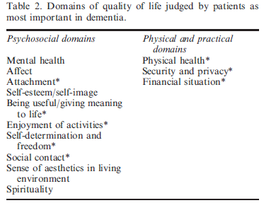
What makes a good day? What people with dementia say
Schölzel-Dorenbos et al. Aging Ment Health. 2010;14:113-9

Slide 62
Take Home Messages
There are predictable critical decision points in dementia care
Most can be anticipated to minimize crises
Evidence based best-practices can help guide appropriate decisions
What is appropriate may vary by individual
Quality of life issues often dictate transitions
Quality life for both family and the affected person

Slide 63
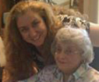
Meet Mrs. P’s Caregiver

