Slide 1
Alzheimer’s Research Report: The Latest from UAB on Treatment, Care and Cure
David S. Geldmacher, MD, FACP; Moderator
Olivio Clay, PhD
Jeremy Heskowitz, PhD

Slide 2

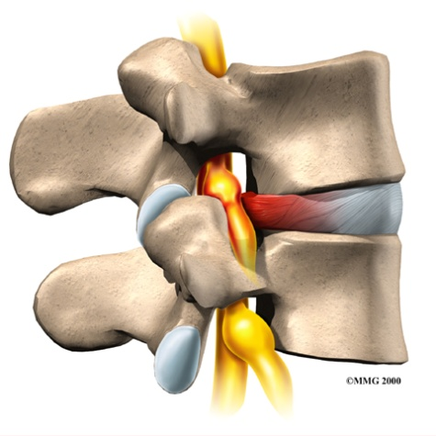
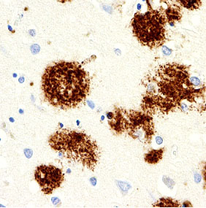
Alzheimer’s Disease vs. Dementia
Understanding the differences
Saying “dementia” is like saying “back pain”
  It describes the symptoms
There are many causes of back pain
  Pinched nerve, slipped disk, arthritis, fracture
There are many causes of dementia
  Alzheimer’s disease is the most common cause in older people

Slide 3
Course of Alzheimer’s Disease
Traditional view
Healthy aging
Mild Cognitive Impairment
Mild AD
Function
Moderate AD
Severe AD
Time

Slide 4
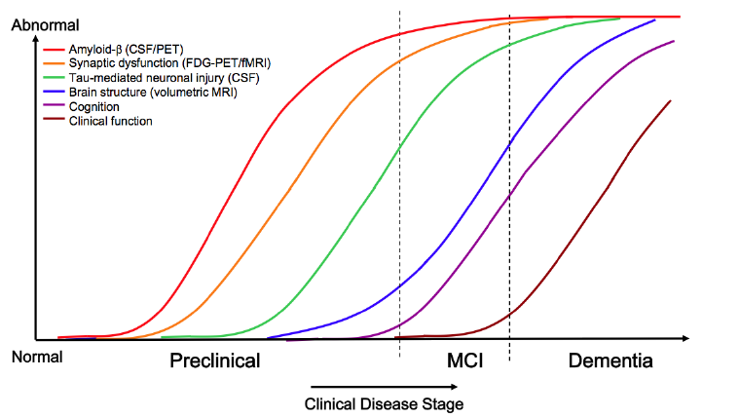
New View: The Alzheimer process starts before the memory symptoms show up
Sperling et al. Alzheimer’s and Dementia, 2011;7:280-92.

Slide 5
Where do the phases of research apply
MEDICAL TREATMENT
PREVENTION
CARE
Sperling et al. Alzheimer’s and Dementia, 2011;7:280-92.

Slide 6
Major Branches of AD Research
Causes
  Genetics
  Risk Factors
  Mechanisms at the cellular level
Diagnosis
  Biomarkers
  Imaging
Treatment
  Symptom Relief
  Reduced Progression
  Neural Regeneration
Care
  Best models for care
  Individualized approaches

Slide 7


Cognitive resilience against Alzheimer’s disease:
Mechanisms and therapeutic windows for prevention
Jeremy H. Herskowitz, Ph.D.
Patsy W. and Charles A. Collat Scholar of Neuroscience
Assistant Professor of Neurology and Neurobiology
Center for Neurodegeneration and Experimental Therapeutics

Slide 8
Today’s seminar
a) Questioning a mystery of Alzheimer’s disease
b) Making a discovery about Alzheimer’s disease
c) Testing a new therapeutic strategy

Slide 9
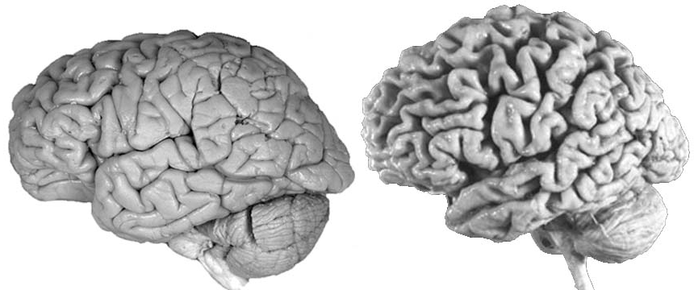
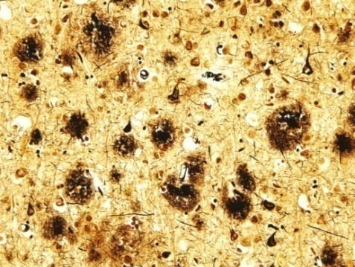
Alzheimer’s disease pathology
Healthy aging
Alzheimer’s disease
Clinical manifestation:
deficits in cognition
learning and memory language impairments
amyloid plaques
neurofibrillary tangles
Currently, 5.4 million are living with Alzheimer’s disease in the US.
By 2050, it will grow to 13.8 million and cost $1 trillion.
Alzheimer’s Association 2015 Facts and Figures

Slide 10
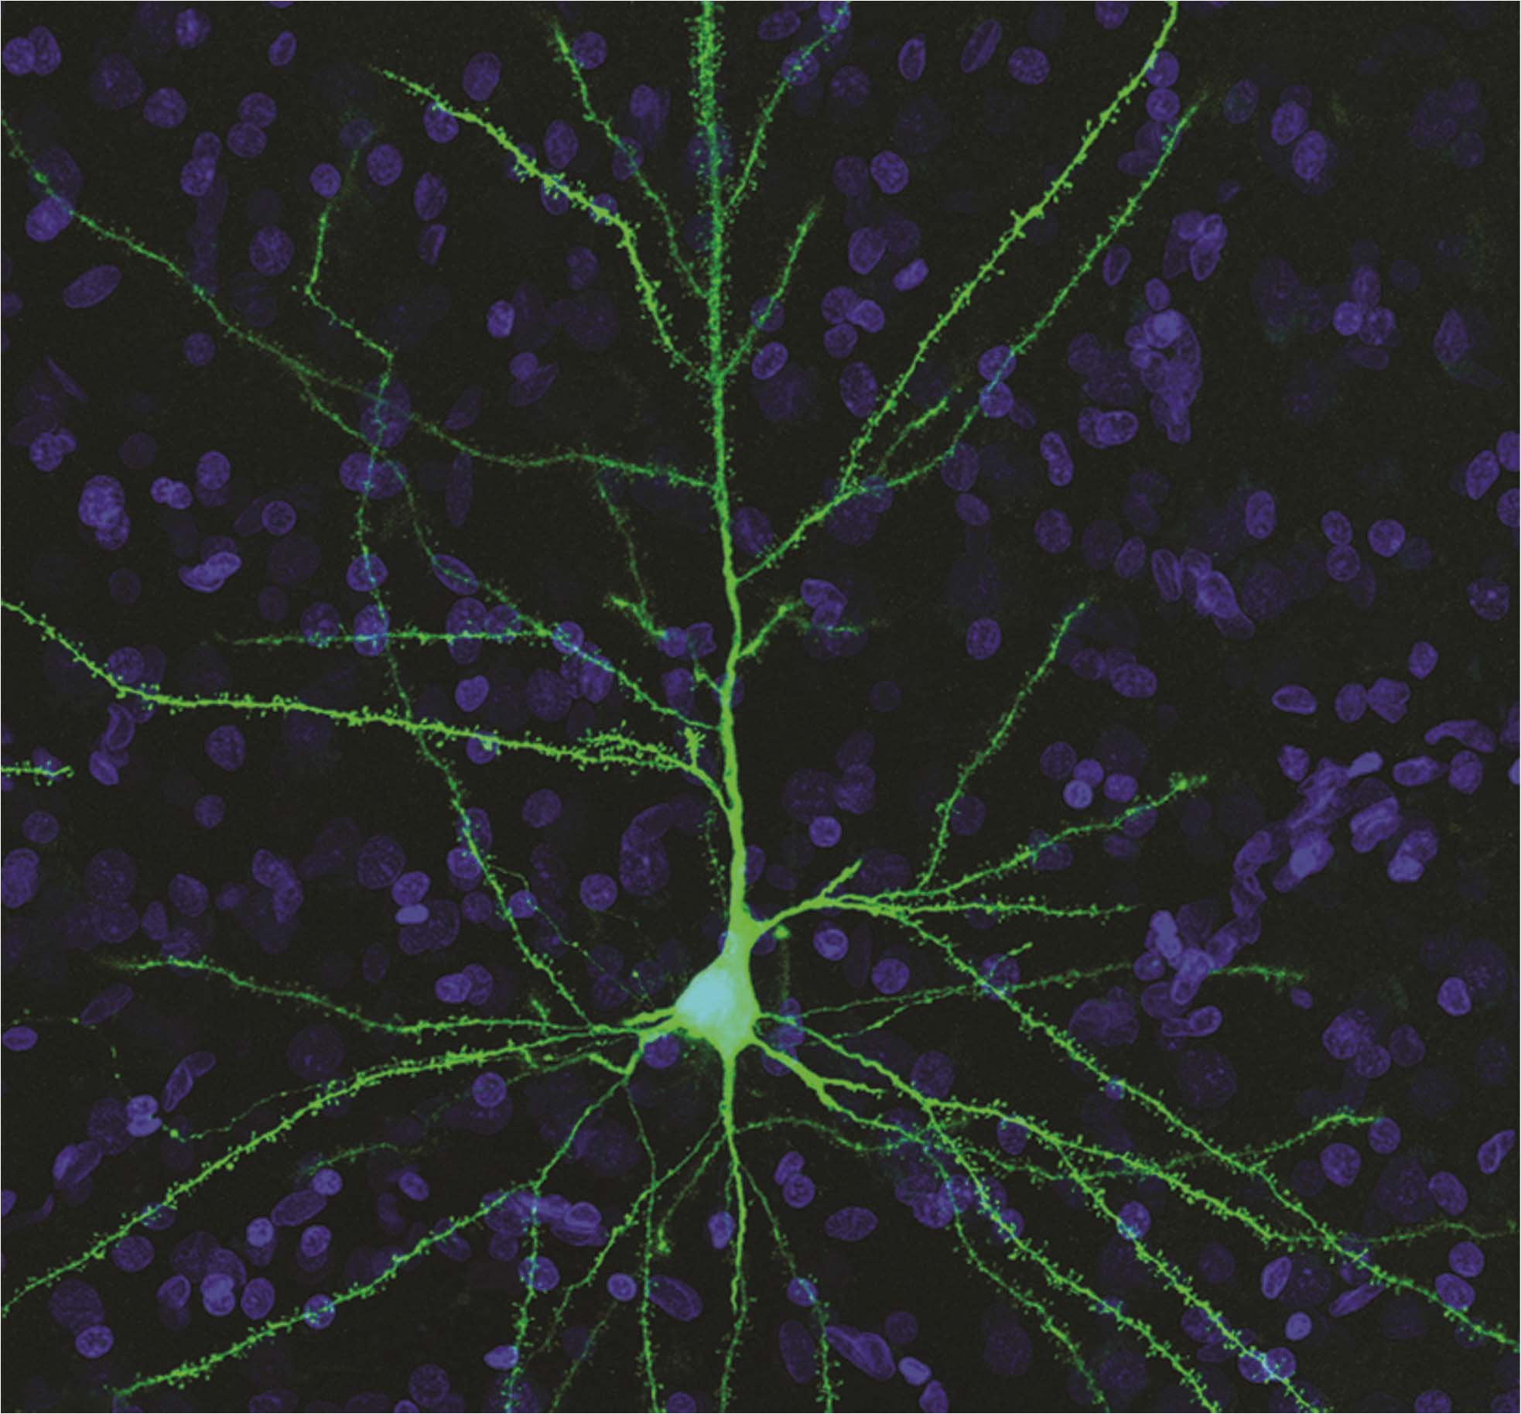
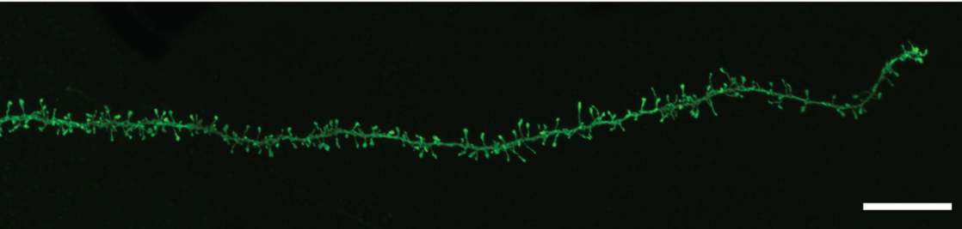
Synapse loss in Alzheimer’s disease
Healthy aging
Alzheimer’s disease
Dendrite arm with dendritic spines
Healthy Cortex Neuron
Synapse and dendrite loss correlate more strongly with cognitive decline than pathologic markers of AD. DeKosky, S.T. and S.W. Scheff, Ann Neurol, 1990.

Slide 11
A major question in the field of Alzheimer’s research
Healthy aging
Alzheimer’s disease
with no dementia
Alzheimer’s disease
with dementia
Dendrite arm with dendritic spines

Slide 12
Today’s seminar
a) Questioning a mystery of Alzheimer’s disease
b) Making a discovery about Alzheimer’s disease
c) Testing a new therapeutic strategy

Slide 13

Are the number of synapses or dendritic spines different in Alzheimer’s patients with no dementia?
Healthy aging
Alzheimer’s disease
with no dementia
Alzheimer’s disease
with dementia
Hypothesis: The synapses or spines in Alzheimer’s patients are different than the synapses and spines in a dementia patient.
Ben Boros

Slide 14
Are the number of synapses or dendritic spines different in Alzheimer’s patients with no dementia?
Healthy aging
Alzheimer’s disease
with no dementia
Alzheimer’s disease
with dementia
Frontal Cortex tissue from:
Golgi Stain
  Silver chromate stain for impregnating neurons, highlighting dendrites
  4 weeks in impregnation solution
Bright-field Microscopy
  20 dendrites per patient
  Dendrite criteria: layer 2 or 3 neurons, consistent thickness

Slide 15
Are the number of synapses or dendritic spines different in Alzheimer’s patients with no dementia?
Healthy aging
Alzheimer’s disease
with no dementia
Alzheimer’s disease
with dementia

Slide 16
Are the number of synapses or dendritic spines different in Alzheimer’s patients with no dementia?
Healthy aging
Alzheimer’s disease
with no dementia
Alzheimer’s disease
with dementia

Slide 17
Are the number of synapses or dendritic spines different in Alzheimer’s patients with no dementia?
Healthy aging
Alzheimer’s disease
with no dementia
Alzheimer’s disease
with dementia

Slide 18
Today’s seminar
a) Questioning a mystery of Alzheimer’s disease
b) Making a discovery about Alzheimer’s disease
c) Testing a new therapeutic strategy

Slide 19
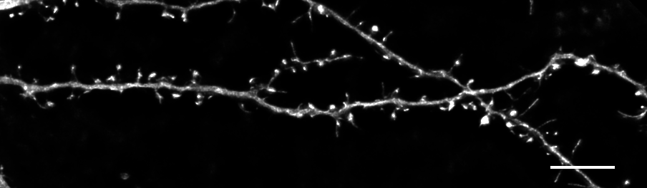
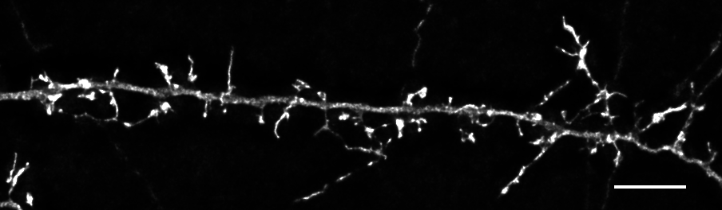
Targeting synapses or spines with a new drug candidate for Alzheimer’s disease treatment
Mock
Y-27632
Swanger et al Cellular Logistics 2015

Slide 20
This drug increases the number of synapses or spines: a possible Alzheimer’s treatment
Swanger et al Cellular Logistics 2015

Slide 21



Acknowledgements and collaborations
Herskowitz lab
Collaborators
Ben Boros
Erik Gentry
Kelsey Greathouse
Ben Henderson
Kendall Curtis
Emory ADRC:
Marla Gearing, PhD
Reaction Biology Corporation:
Yangbo Feng, PhD
Funding sources

Slide 22
Finding effective therapies

Slide 23
The Drug Development Process
Biological Observation
Year 01
Target Identification
Binding Properties
Chemical Synthesis
Pre-clinical Investigation/Toxicology
Clinical Trials
FDA Approval
Year 10-15
The average cost to develop a new drug is >$2.6 billion, before the first Rx is written
Van Eldik et al, Alz Dis Assoc Disord 2002;16 (Suppl. 1):S18-S28

Slide 24
Drug Development
Percent of Costs by Stage
Synthesis and Extraction
12%
Biological Activity Tests
15.1%
Animal Toxicity
5.2%
Formulation / Stability
9.0%
Bioavailability Testing
2.4%
Regulatory Documentation
4.4%
Clinical Testing
28.3%
Manufacturing Development
9.9%
Other
7.9%
Van Eldik et al, Alz Dis Assoc Disord 2002;16 (Suppl. 1):S18-S28

Slide 25
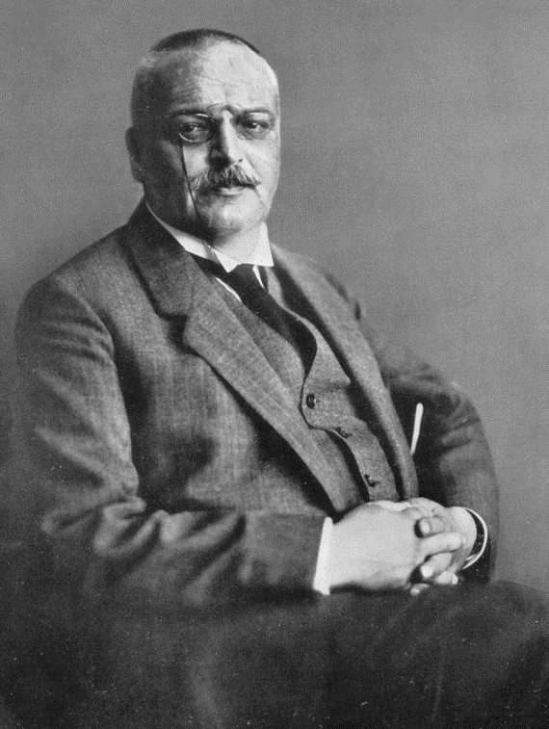
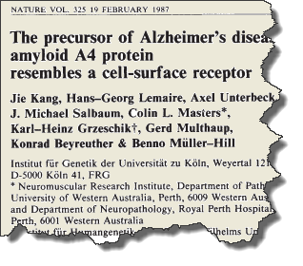
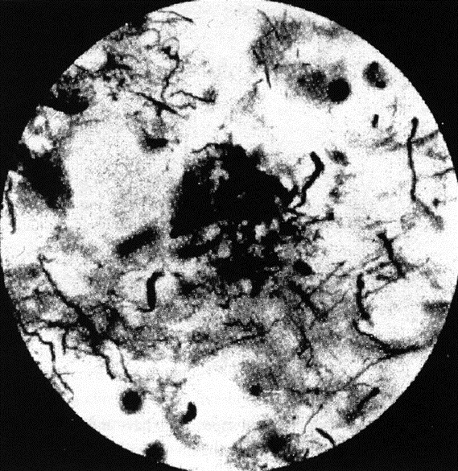
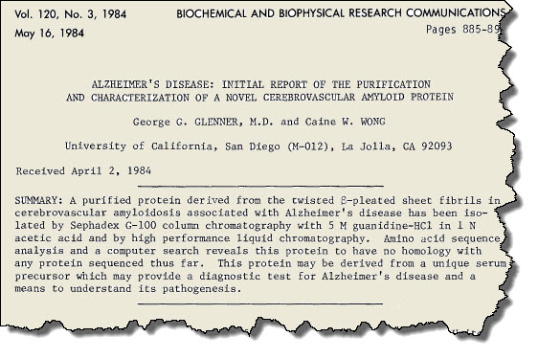
Tracking a treatment
Amyloid Gene
Kang and others 1987
Amyloid protein is purified
Glenner and Wong, 1984
Plaques Discovered
Alzheimer, 1906

Slide 26
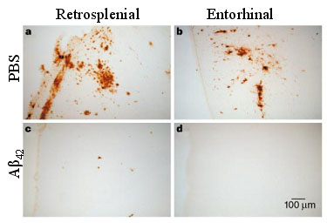
Tracking a treatment
Vaccinating mice with amyloid removed plaque from brain - 1999
Schenk D et al. Nature 1999;400:173-177

Slide 27
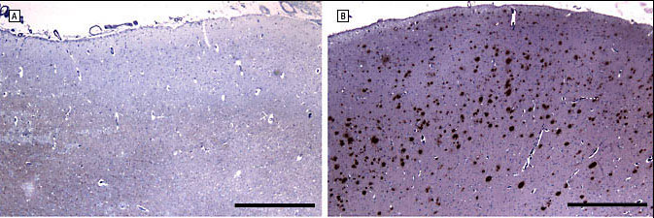
The Alzheimer vaccine story
The bad news - 2007
Vaccinating people with amyloid caused brain swelling and inflammation in 6% of the subjects
In patients who did not get encephalitis, plaques were cleared from the brain, but dementia progression did not stop
Bombois et al. Arch Neurol 2007;64(4):583-7

Slide 28
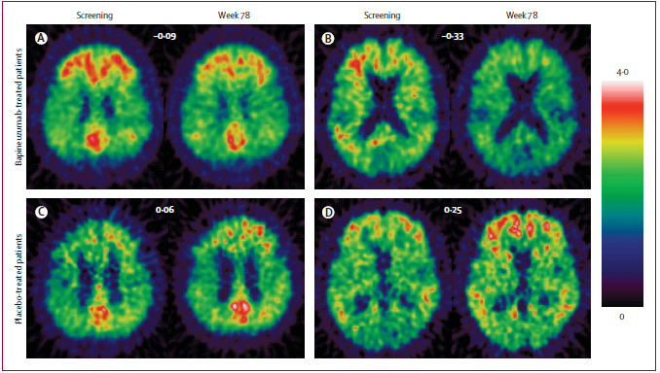
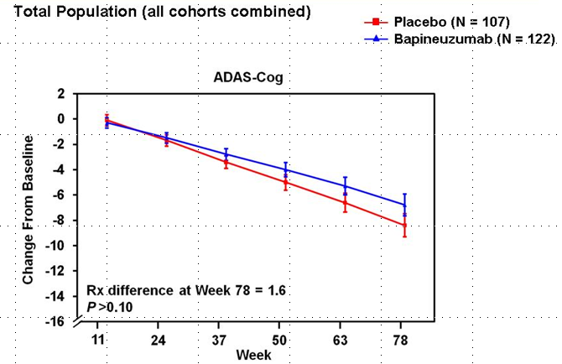
Removing amyloid from the brain
The good news – amyloid can be removed from the brain -2010
More bad news
No effect on memory in people who had mild or moderate Alzheimer’s
Disease

Slide 29

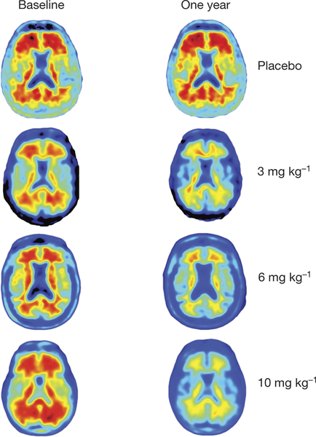
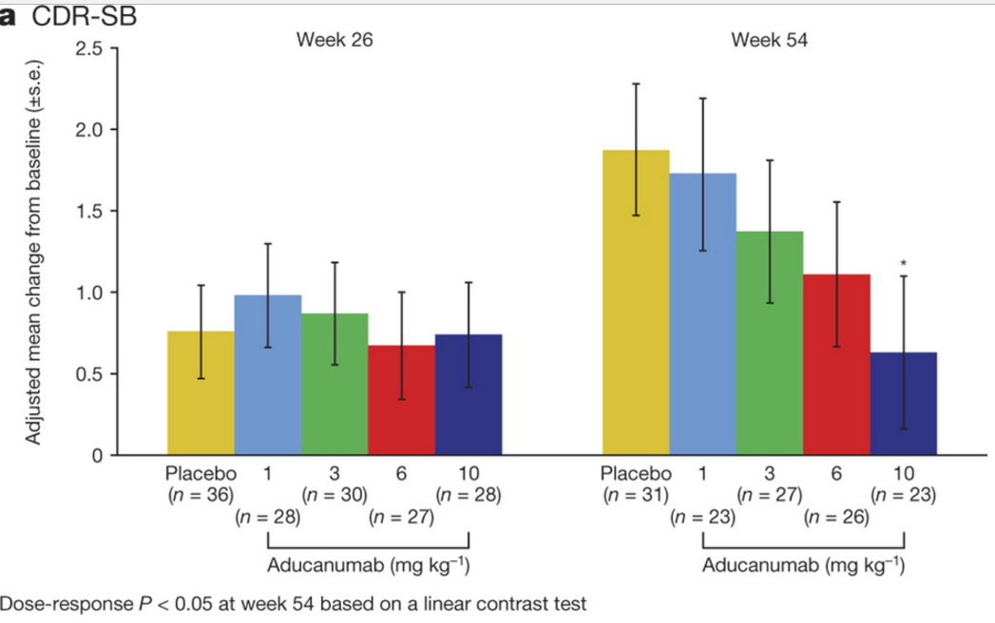
Tantalizing hints of success
Aducanumab treatment in very early AD
September 1, 2016
Dose-related response in early AD

Slide 30
Understanding Treatment Effects
Cure
No symptoms
Symptoms evident
Function
Disease Arrest
Begin Treatment
Slowed Progression
Time

Slide 31
Understanding Treatment Effects
Prevention
Asymptomatic
Begin Treatment
Neuroprotection
Symptomatic
Function
Time

Slide 32
Current Treatments:
Their Impact on Care

Slide 33
Drug Treatment Effects on Caregiver Time
30
Placebo
(n = 160)
*
20
Galantamine
24 mg/d
(n = 165)
Change From Baseline in Daily Time Spent Assisting With ADL (min)
10
0
–10
–20
–30
–40
–50
*P < .05 vs baseline.
Sano et al. Int J Geriatr Psychiatry. 2003;18:842-850 (I).

Slide 34
Drug Treatments and Caregiver Distress
Behavioral Symptoms
Open Label
Double Blind
16
Mean NPI-D (SEM) score
N=134
14
Donepezil
Placebo
12
p <.001
10
p <.001
N=45 (82% complete)
8
6
N=96
N=35 (85% complete)
4
p <.05
p <.05
2
0
0
6
12
18
24
Study Week
Mean age = 80.9; Placebo:Drug ratio 3:2
Holmes et al. Neurology. 2004;63:214-219 (I).

Slide 35
Delay to Nursing Home Placement (NHP)
Eight (of 9) published studies report delayed admission or reduced risk for NHP with drug treatment
  Risk reduction is 28% at 1 year, 21% at 2 years, and is indistinguishable after three years²
Caregiver support also delays NHP, but do not add to the medicine’s effects³
Many confounding factors influence these studies
All delayed NHP results probably reflect access to consistent dementia care and quality of family interactions
¹ Lopez et al. JNNP 2002;72:310-314 (II-2)
² Becker M. et al ADAD 2006;20:147-52 (II-2)
³Brodaty H. Am J Geriatr Psychiatry. 2009 ;17:734-43

Slide 36
There are more than 50 Current Clinical Trials in Alzheimer’s Disease and Mild Cognitive Impairment
Symptomatic (target: Neurotransmitters)
  Boost acetylcholine
  Reduce behavioral symptoms
Disease Modifier Targets
  Amyloid (Reduce production, Increase clearance)
  Insulin
  Mechanisms of Cell Death
  Blood vessel health
  Immune modifiers
  And more…

Slide 37
What else can we do?
Supporting the well-being of patients and families

Slide 38
Caring for a Family Member: Longitudinal Outcomes, Protective Resources, and Decisions about Nursing Home Placement
Olivio J. Clay, PhD
Associate Professor
Department of Psychology

Slide 39
Caregiving Facts
Estimated that by 2050 the number of individuals living with Alzheimer’s disease (AD) could reach 16 million.
Over 70% of patients with AD or other related dementias remain in the community.
Over 15 million individuals are informal caregivers of some type and they provide almost 18 billion hours of unpaid care (Alzheimer’s Association, 2014).
These caregivers are at risk for negative psychosocial and physical health consequences due to the chronic stress involved.
Notes:
Good to list other types of caregivers (stroke, etc…)

Slide 40
Stress Process Model
Examine psychosocial effects of caregiving.
Pearlin divided stress process into 4 domains
  Background and context
  Primary, secondary, and extrinsic stressors
  Mediation of stress
  Measuring the effects of stress
Notes:
background and contexts of the stress process. The characteristics of the caregiver have potential influences on the outcomes associated with the caregiving role. Demographics such as age, socioeconomic status, race and gender are compared to help researchers determine if caregivers are a part of groups that may have unequal distributions of opportunities, responsibilities, or privileges.
These include events associated with patient deficits in the areas of cognitive impairment, activities of daily living (ADL’s), instrumental activities of daily living (IADL’s), and memory and behavioral problems. The memory and behavioral problems of the patient are the primary stressors most closely related to caregiver depression (Alspaugh et al., 1999; Schultz et al., 1995). The stress associated with the caregiving role has additional negative consequences that affect the lives of the family members who provide primary care for their loved ones. These secondary stressors surface in the form of decreased work performance, fewer opportunities for leisure activities or recreation, and even additional problems with a spouse if the caregiver is married. Caregivers also encounter additional extrinsic stressors. These include life events such as having a car accident that are unrelated to the caregiving role.
The third domain of the stress process model involves the mediation of stress. Researchers try to determine why there are individual differences in resilience to caregiving. The mediating aspects of social support and coping play a major explanatory role
The psychosocial outcomes, which represent caregiver well-being, are the final domain of the stress process model. The model would be incomplete if we had no way to measure the effects of stress on the everyday life of the caregiver.

Slide 41
Family Caregiver Research Project (FCRP)
Conducted at UAB
Compare African American (AA) and White caregivers to a group of matched controls.
Criteria for caregivers
  Family member of patient by blood or marriage
  Primarily responsible for patient’s care
  Reside within a 50-mile radius
Notes:
264 caregivers (102 AA, 162 White)
Caregivers 28 to 89 years of age.
Patients 51 to 100 years of age
AA Caregivers compared to White
Younger
Female
Children

Slide 42
Assessment Intervals
Initial caregiver and patient baseline measures were collected.
Annual follow-ups until nursing home placement (NHP), death, or dropout.
Every 6 months after NHP.
Every 6 months after patient death.
Notes:
(2) Up to 6 years following baseline

Slide 43
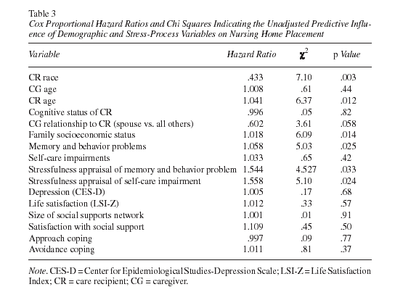
Stevens, A., Owen, J., Roth, D., Clay, O., Bartolucci, A., & Haley, W. (2004). Predictors of time to nursing home placement in White and African American individuals with dementia, Journal of Aging and Health, 16, 375-397.
Notes:
AA were being placed in NH at a rate that was only 43% of the rate for Whites

Slide 44
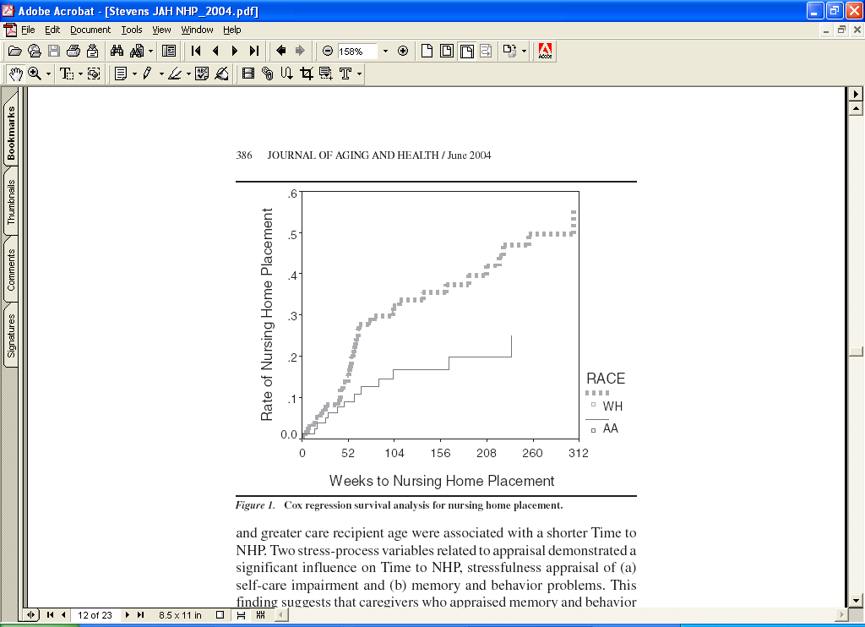
Notes:
Stressfulness associated with memory and behavioral problems was the strongest explanatory factor for why there was a racial difference.

Slide 45
Caregiver Depressive Symptoms
Notes:
Higher SES less depressed
AA reported fewer depressive symptoms than Whites

Slide 46
Caregiver Life Satisfaction
Notes:
Higher SES more satisfied
Race*Time interaction AA remained relatively stable decrease for Whites

Slide 47
Amount of social support perceived over five years of community caregiving
Clay, O., Roth, D., Wadley, V., & Haley, W. (2008). Changes in social support and their impact on psychosocial outcome over a 5-year period for African American and White dementia caregivers, International Journal of Geriatric Psychiatry, 23, 163-170.
Notes:
The total number of support persons available was the sum of individuals reported as helpful across all areas.
Significant time effect total social support available decreased over time.

Slide 48
Caregiver’s satisfaction with their social support network
Notes:
Older adults more satisfied
AA more satisfied than Whites
Discuss socioemotional selectivity (Carstensen)

Slide 49
Caring for Mom & Dad
PBS documentary (2015)
Segment describes Nicole (daughter) who is caring for her father
Describes her difficulties as a caregiver and an innovative adult overnight program to help caregivers get some sleep.
https://www.youtube.com/watch?v=tqcH_OxRAjk

Slide 50
New York University Caregiver Intervention (NYUCI)
Randomized trial
Targeted intervention to increase social support in spouse caregivers
Intervention
  Individual (2) and family counseling (4) – in person
  Support group participation
  Ad hoc counseling as requested by phone
Notes:
Individual and family counseling was custom-tailored to fit the needs of each family and took place within the first 4 months.
Intervention compared to usual care control group.
Recruited through NYU Alzheimer’s Disease Center and referrals (from the New York City Chapter of the Alzheimer’s Association, other community organizations, private physicians, and other study participants)
406 caregiver/patient dyads
203 treatment
203 usual care
206 recruited in the first cohort, 200 in second cohort (1991)

Slide 51
Participants
Recruited through NYU Alzheimer’s Disease Center and referrals
406 caregiver/patient dyads
  203 treatment
  203 usual care
206 recruited in the first cohort, 200 in second cohort (1991)
Notes:
from the New York City Chapter of the Alzheimer’s Association, other community organizations, private physicians, and other study participants

Slide 52
Assessment Intervals
Baseline, 4 months, 8 months, 1 year
After the 1st year, every 6 months while in community
Every 6 months after NHP
Every 6 months following patient death for up to 2 years

Slide 53
Probability of nursing home placement (1 – survival probability) as estimated from a Cox proportional hazards model
Notes:
Delay in NHP of about a year and a half (median)

Slide 54
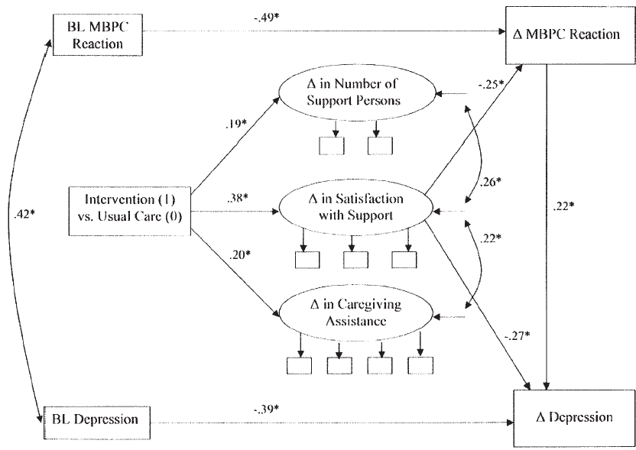
Notes:
Roth, D., Mittelman, M., Clay, O., Madan, A., Haley, W. (2005). Changes in Social Support as Mediators of the impact of a
psychosocial intervention for spouse caregivers of persons with Alzheimer’s disease, Psychology & Aging, 20, 634-644.
(1) This difference can not be completely explained by coping and social support. Additional measures must be accounted for to explain the resiliency of African American caregivers.
(2) These measures show initial changes that tend to become stable over time.
(5) In a study of 3,793 functionally impaired persons age 65 and older from the 1989 National Long-Term Care Survey (NLTCS), Burton et al. (1995) found no differences by race in the size of caregiving networks assisting older disabled adults, but a racial difference was found in the composition of the unpaid caregiving network. Elderly disabled African Americans possessed a greater likelihood of having at least one unpaid caregiver who was not a member of the immediate family when controlling for the size of the network.

Slide 55
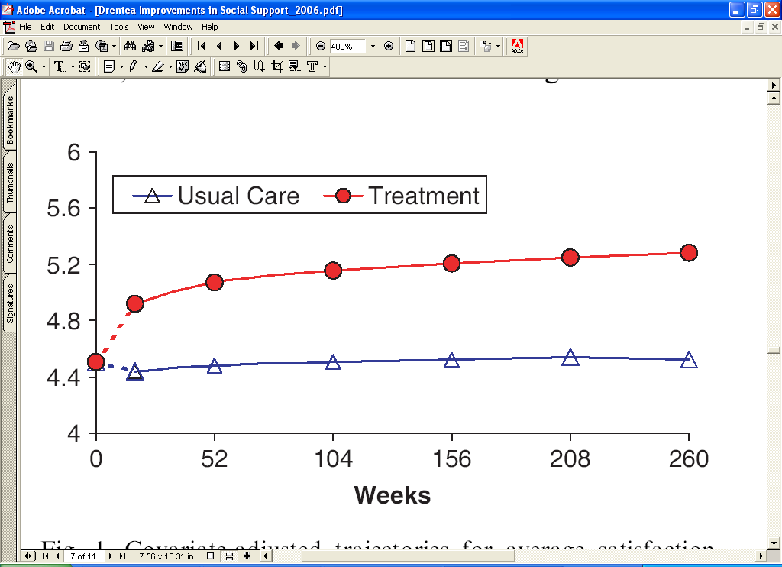
Average Satisfaction with Social Support
Drentea, P., Clay, O., Roth, D., & Mittelman, M. (2006). Predictors of improvement in social support: Five-year effects
of a structured intervention for caregivers of spouses with Alzheimer’s disease, Social Science & Medicine, 63, 957-967.

Slide 56
Summary (NYU Spouse Caregiver Intervention)
The intervention mobilized the social support network, delayed NHP, and improved caregiver adaptation.
An individual’s satisfaction with their social support network was a better predictor of caregiver outcome than network size.
Increases in emotional support, the number of individuals caregivers felt close to, and frequency seeing people in their network partially explained the increase in overall satisfaction.

Slide 57
Implications
Findings from observational investigations such as the FCRP have identified caregivers who are at-risk, as well as, modifiable protective resources such as social support that can be improved with intervention.
Are these findings similar in other samples of caregivers?

Slide 58
Implications (continued)
In a 2015 Cost of Care Survey, it was estimated that the median cost of the care per year provided to nursing home residents ranges from $60,225 in Oklahoma to $259,515 in Alaska.
  Alabama - $76,285
The sample recruited to participate in the NYU caregiver intervention study was primarily White. Is the intervention effective for African Americans?
Notes:
NYU Caregiver intervention delayed NHP by about a year and a half per person.

Slide 59
Clay Pilot Study
Phone Interviews with 39 African American caregivers
Caregiving Issues reported:
  Dealing with memory and behavioral problems
  Dealing emotionally with family member (FM) not remembering them
  Taking care of FM’s financial affairs
  Helping FM with other comorbid conditions
  Transportation difficulty
  Need for a sitter (relief person)
Notes:
AA caregivers more likely to the daughters compared to Caucasians.
Other comorbid conditions such as HPB and diabetes

Slide 60
Tools for Distance Delivery of an Evidence-based AD Family Caregiver Intervention
Completing a short online instructional program about how to use the video teleconferencing program
Being contacted by a licensed provider of the NYUCI
  Nieshia Brown, Ed.S, LPC
  205-492-6216 or 205-960-5820
  starlingconsultingllc@gmail.com
Being randomly assigned to receive either the NYUCI, via video teleconferencing, or help and support as needed over the telephone.

