Slide 1
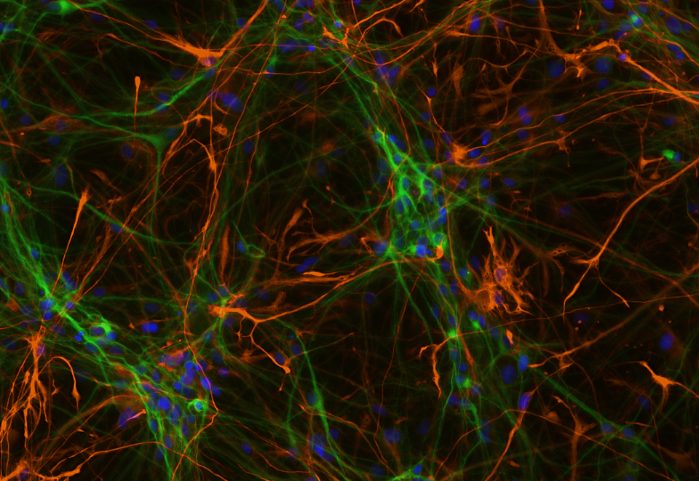
Finding New Causes and Markers of Alzheimer’s with Genomics
Nick Cochran
Postdoctoral Fellow, Myers Lab
HudsonAlpha Institute for Biotechnology
October 17, 2017

Slide 2
HudsonAlpha:
Our missions
in the life sciences
Research
Education outreach
Genomic medicine
Economic development
Notes:
Ideas:

Slide 3
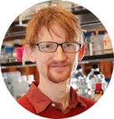
We are a non-profit research and teaching institute
16 Primary Faculty, 115 scientists (209 total employees)
And 5 Adjunct Faculty at UAB and UAH

Slide 4
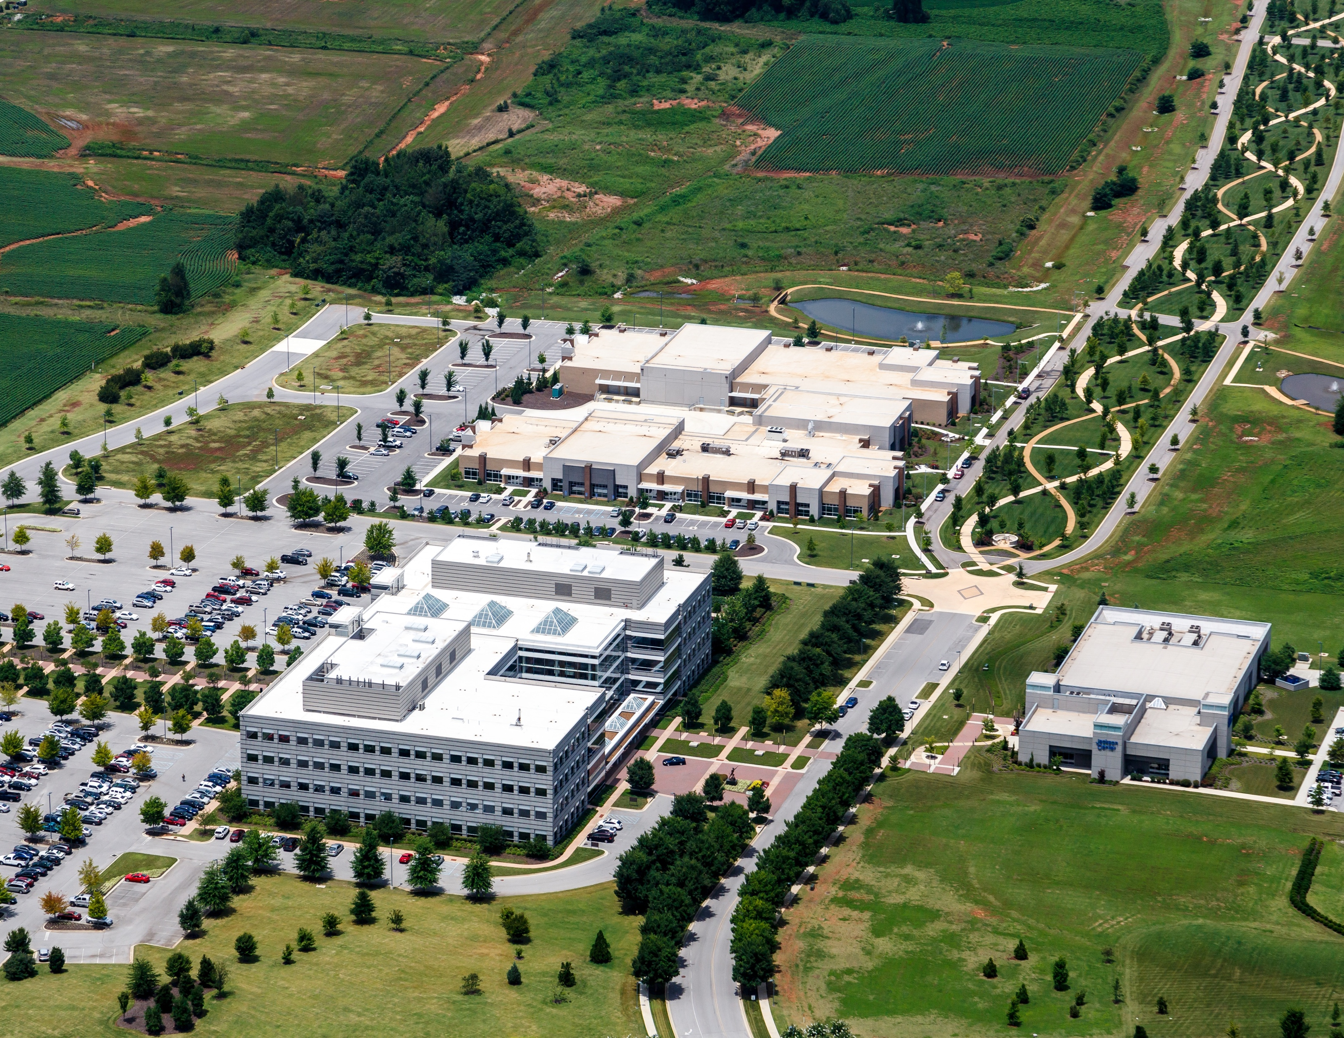
152-acre HudsonAlpha campus
located in the 3,800-acre Cummings Research Park in Huntsville, AL

Slide 5
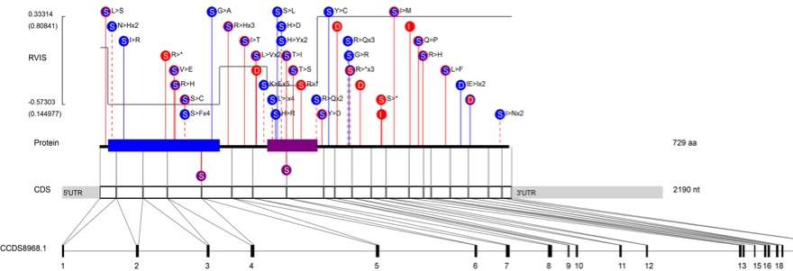
History in Applying Genomics to Neurodegeneration:
Identification of new genes involved in ALS
One of these genes is named TBK1
RVIS
So what?
TBK1 protein is a great target for new drugs to treat ALS

Slide 6
Burden of Alzheimer’s in the U.S.
Total NIH Budget (33B)
Research Budget for AD (0.59B)
With AAA Increase (0.92B)
Alzheimer’s Association (alz.org)
Ideal Amount (2.0B)

Slide 7
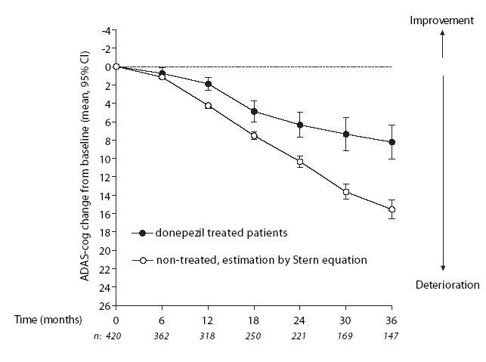
Current Therapies for Alzheimer’s
Cholinesterase Inhibitors
Memantine
Wallin et al., DGCD 2006
Reisberg et al., NEJM 2003
Both delay decline for about 6 months
Can delay nursing home placement by about 2 years
Neither target the disease pathology directly

Slide 8
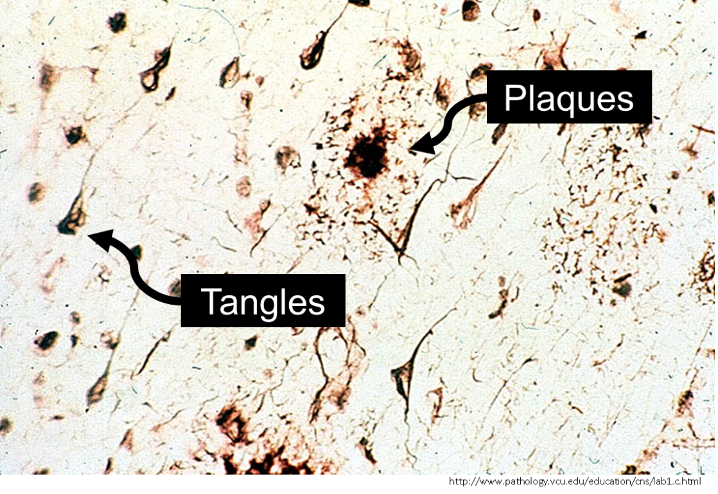
To Improve Treatment, We Need to Understand Alzheimer’s Better – What is Alzheimer’s Disease?
Presents as Deficits In:
Memory
Executive Function
Language
Visuospatial Ability
Orientation to Time
alz.org, psychiatry.org
Pathology at Autopsy:

Slide 9
Pathology at Autopsy:
Associated with “Normal” Aging
Associated with Disease
Braak et al., 2011

Slide 10
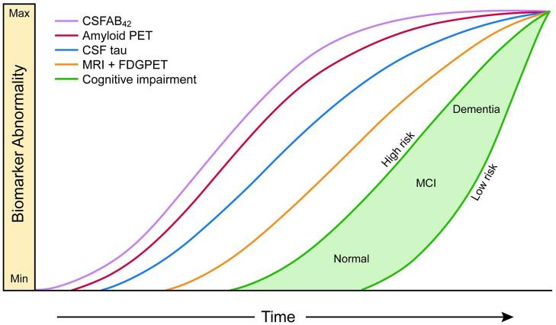
Brain Changes Begin Decades Before Alzheimer’s is Diagnosed
-20 Years
-10 Years
Diagnosis
Adapted from Bateman et al. NEJM (2012) and Jack, Jr. et al. Lancet neurology (2013)

Slide 11
Video of Alzheimer’s Pathology Starting Before Symptoms

Slide 12
HudsonAlpha has established a program to apply genomics to neurodegeneration in 3 key areas:
Whole Genome Sequencing
Biomarkers
Gene Regulation

Slide 13
Whole Genome Sequencing
Can we find new genetic causes for Alzheimer’s?
With Collaborators: Early Alzheimer’s / Frontotemporal Dementia
With UAB: Family based Early / Atypical Neurodegeneration
Planning to genotype 1500-2000+ cases & controls (WGS & others)
Expertise from big ALS project, CSER, etc.

Slide 14
FTD/AD WGS – Collaborators
Erik Roberson, M.D., Ph.D.
UAB
Bruce Miller, M.D.
UCSF
Ken Kosik, Ph.D.
UCSB

Slide 15
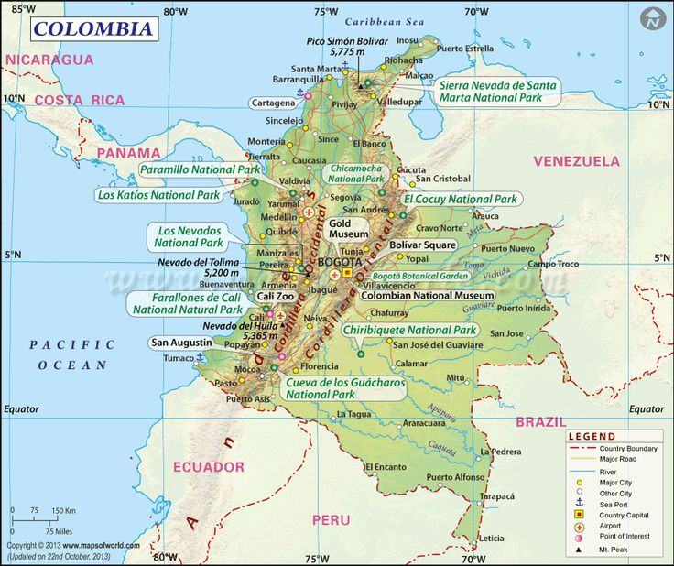
An Isolated Region in Colombia – Neurologic Cases There

Slide 16
variant = bad news
You and I have ~5 million genetic variants between each other!
How do we find the ones important for disease?

Slide 17
Spot the Variants

Slide 18
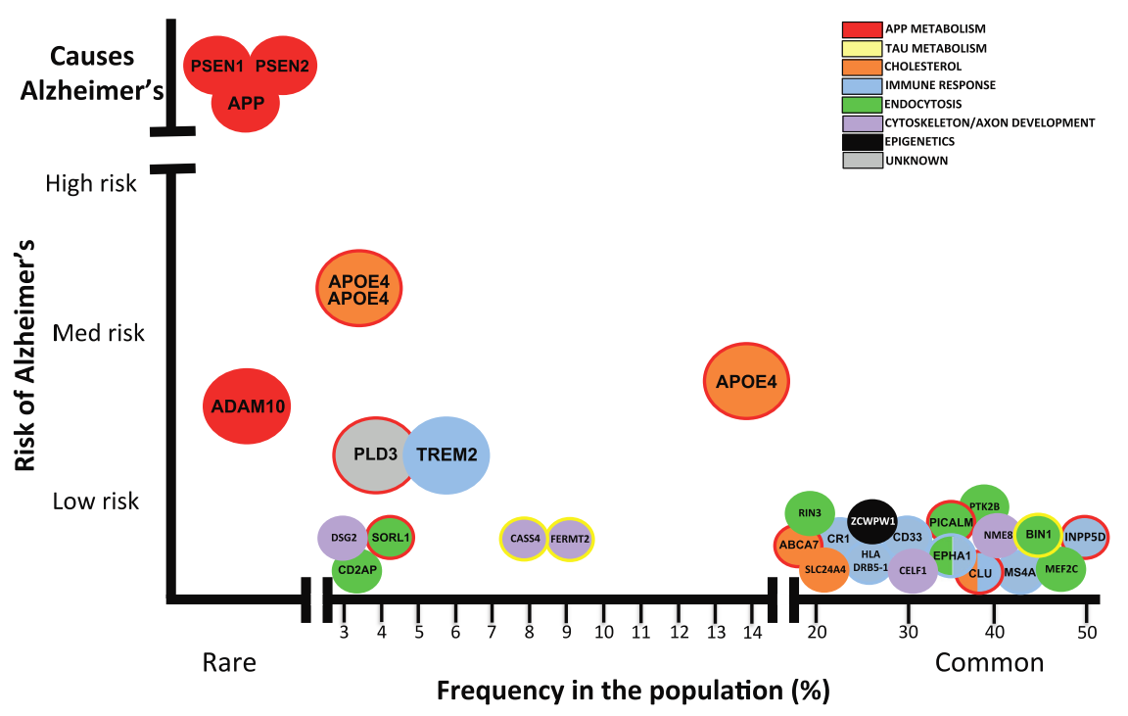
How will HA Impact Alz.? Current Alz. Genetics
Very rare,
familial Alzheimer’s
Largely Unexplored
Unlikely to find new common genes with high risk
Very common
genetic changes,
but low risk increase
Population Frequency
Karch and Goate, 2014

Slide 19
How will HudsonAlpha Impact Alzheimer’s?
Insights from Current Alzheimer’s Genetics
Very rare,
familial Alzheimer’s
Largely Unexplored
This is where new treatments are coming from!
Many more treatments could come from new rare variant discoveries
Rare
Karch and Goate, 2014

Slide 20
Genomics for Local Neurodegeneration Cases
Early Alzheimer’s / Frontotemporal Dementia
Enrolling parents if available, or siblings
Also collecting other types of samples for further study
Initial analysis completed on 10:
5 strong returnable results
Lots of possible multiple contributors

Slide 21
Biomarkers
Can we develop a blood test for Alzheimer’s?
Measure the Immune Repetoire
Expertise from iRepetoire (associate company) & Myers lab

Slide 22
Immune repertoire measurements
Immune system in a healthy person
Immune system in a cancer patient
Apply this same technology to Alzheimer disease as a way of detecting the disease early, allowing earlier intervention

Slide 23
Gene Regulation
What are the on/off switches for neurodegeneration genes?
End goal: treatment targeting neurodegeneration genes
Expertise from ENCODE project, ongoing Huntington’s project

Slide 24
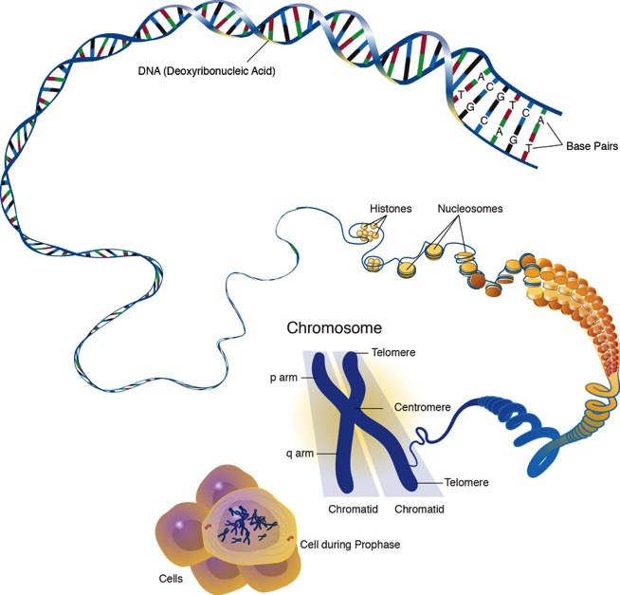
How We Can Find On/Off Switches for Genes

Slide 25
Hope for New Therapies is on the Horizon
Because of Genetic Discoveries in AD
Biogen
Liu-Seifert et al., 2015
2 Phase III trials underway
Readout end of 2016
2 Phase III trials started
Readout end of 2021
*HudsonAlpha does not endorse any particular company or drug

Slide 26
Resource: AlzForum.org
Good Coverage of Research Details (Including Clinical Trials)

Slide 27
Resource: alz.org
Alzheimer’s Association
Signs of Alzheimer’s
About Alzheimer’s
Advocacy
Local Information
Clinical Trials

Slide 28
Resource: trialmatch.alz.org
How to Get Involved in a Clinical Trial
*Always talk to your doctor about what clinical trials you or your loved one may be eligible for.

Slide 29
Conclusions
Alzheimer’s is becoming a big problem as we age
Brain changes start early – so should treatments
New treatments are on the horizon (30%+ benefit)
Discoveries from HudsonAlpha could reveal new treatment opportunities
AlzForum.org for research news
Alz.org for other resources

Slide 30
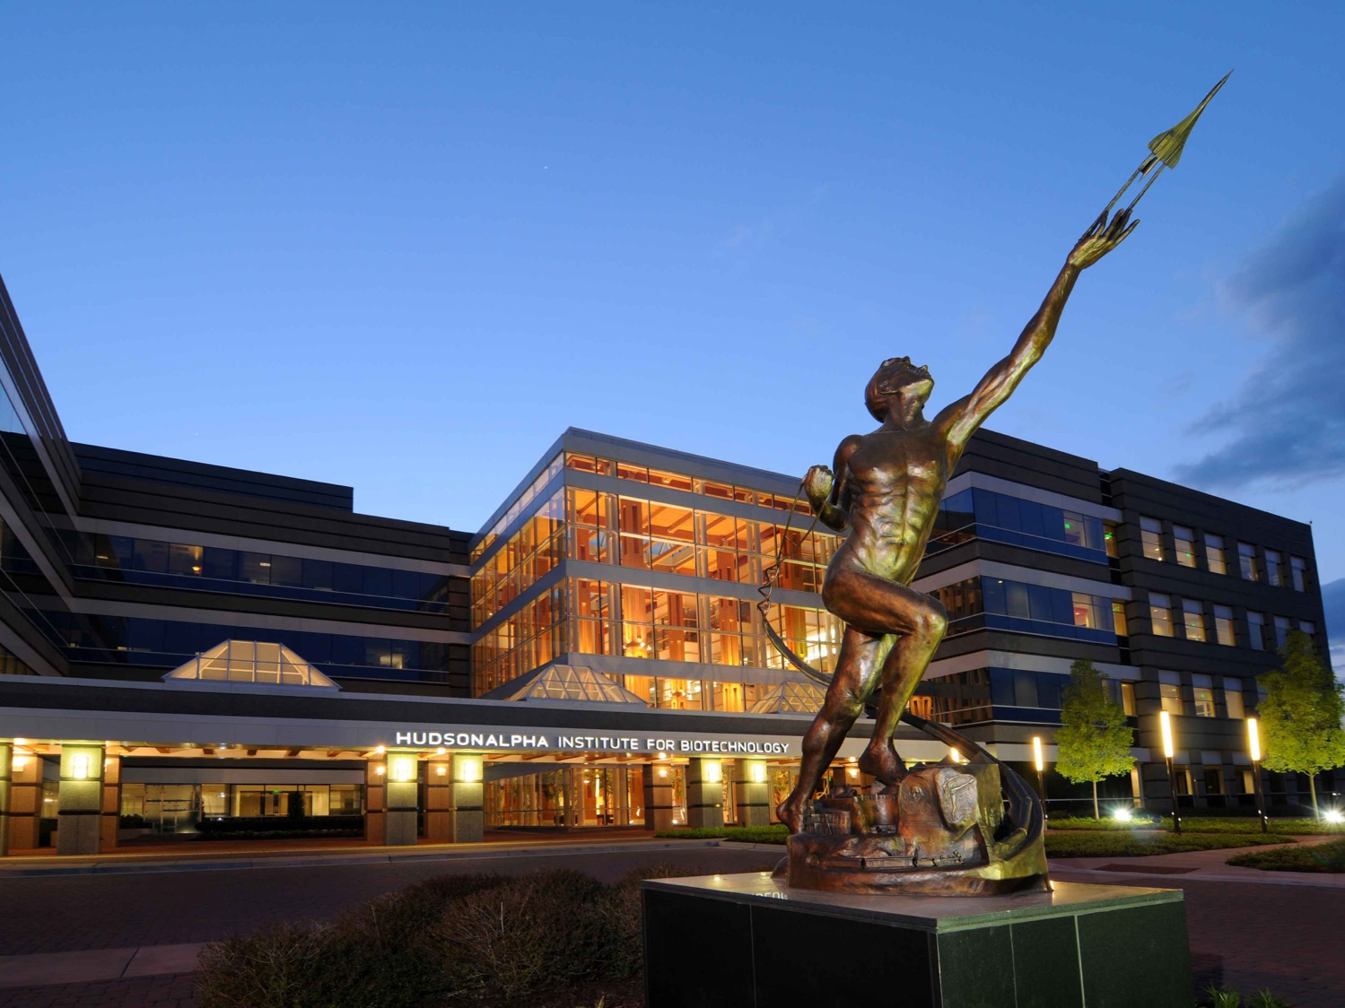
Thank you for listening!
Questions?

